Slide 1
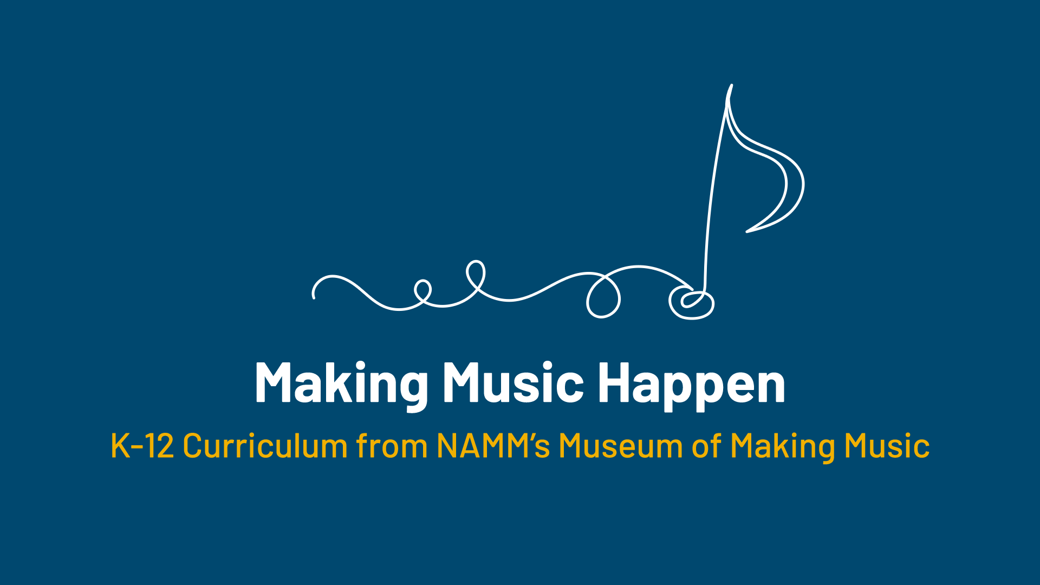

Slide 2
Ready for Retail!

Slide 3
Lesson Objectives
Define “retail” and “marketing.”
Identify one retailer that has made an impact on music-making.
Create a novel idea for a new music retailer.
Draw and illustrate a store and develop a “pitch” for why your store should be supported.

Slide 4
What are some things you use daily?

Slide 5
What are some stores you might
purchase these items from?

Slide 6
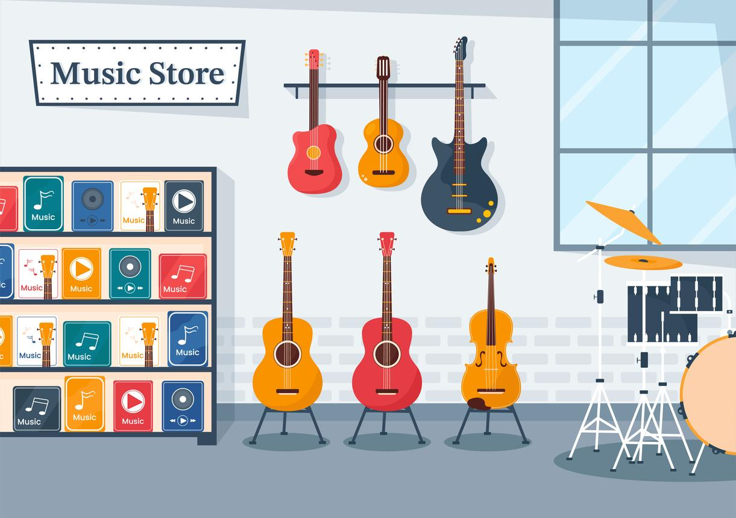
What does
"retail" mean?
Retail is the sale of goods to the public.

Slide 7
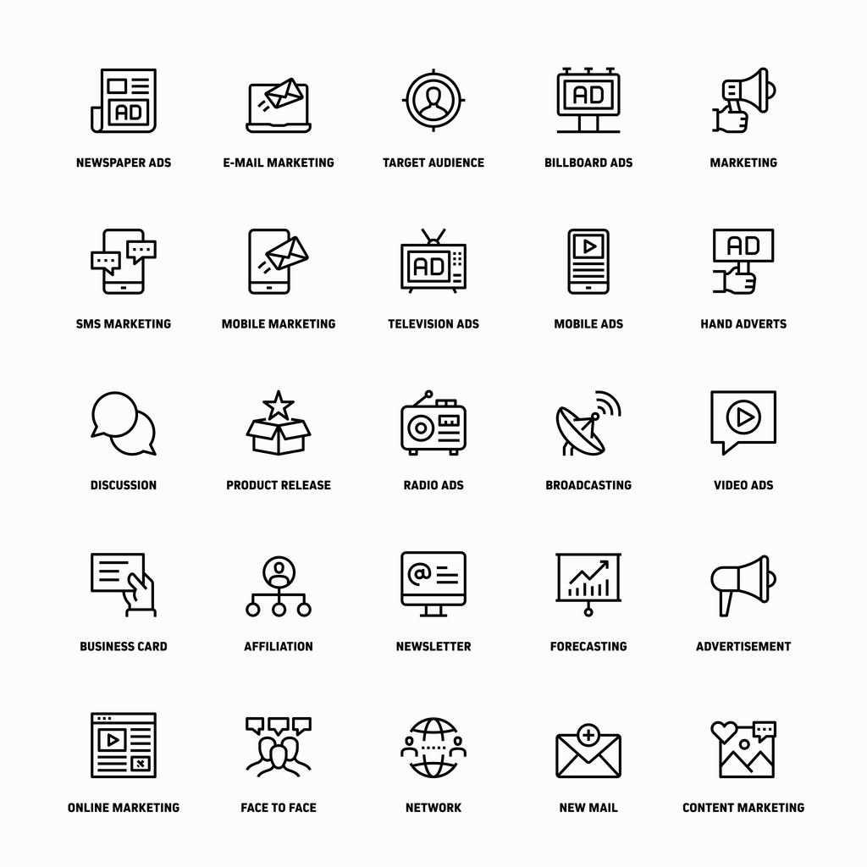
What does "marketing" mean?
Marketing is the activity or business of promoting and selling products or services.

Slide 8
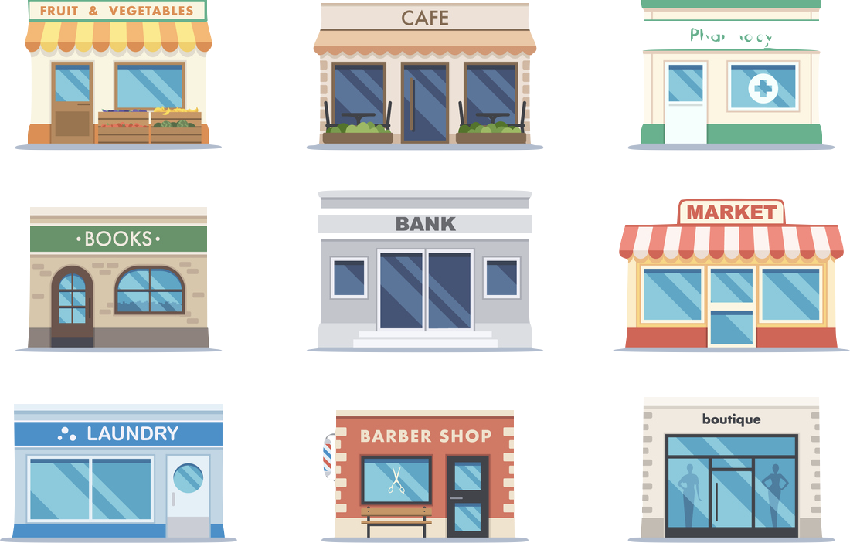
What is your favorite retail store and why?

Slide 9
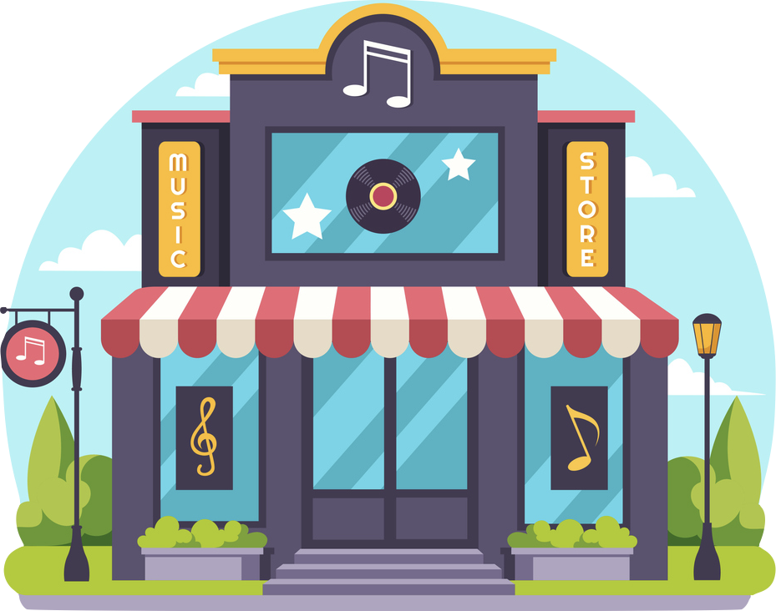
Do you know of any music stores?

Slide 10

What do you think makes a store successful?

Slide 11
Music retailers that have shaped the music industry…
Today, you will learn stories of some music retailers that have shaped the music industry and apply these stories to a new store that you create!

Slide 12

Sweetwater
Sweetwater is one of the largest music retailers in the country.
Sweetwater was started by Chuck Surack to provide equipment for music-makers.
What does Chuck say is the key to success at Sweetwater?
(answer on your worksheet)
Notes:
start the video at 15:10

Slide 13


Slide 14
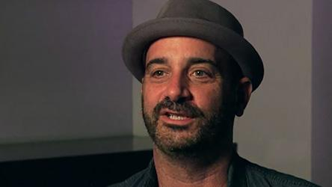
Reverb
Reverb was started in 2013 by David Kalt as an online platform to buy and sell musical products (both new and used).
It is now owned by Etsy.

Slide 15
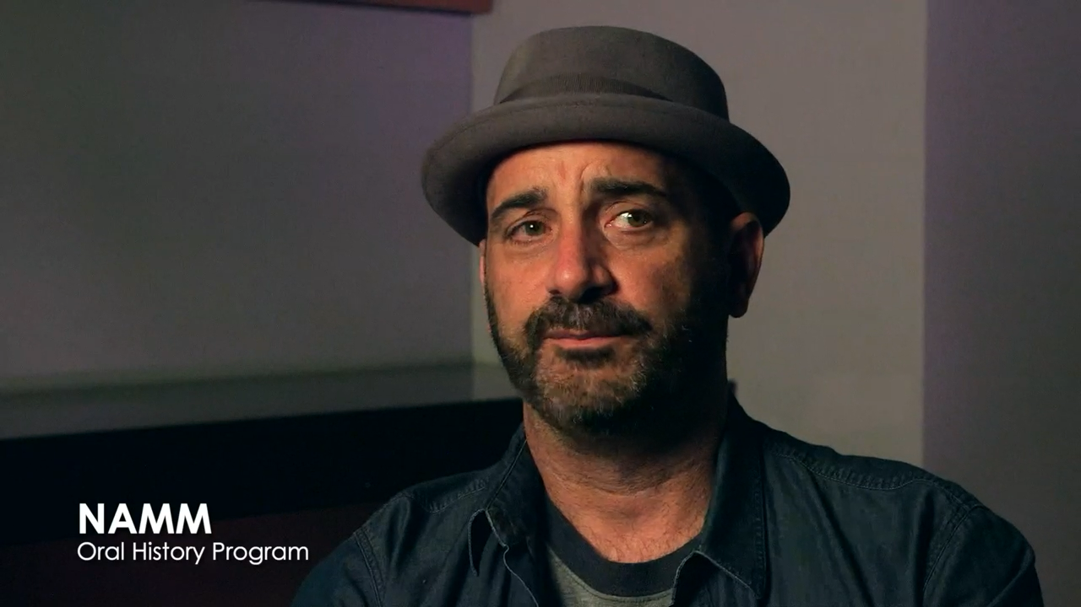

Slide 16
Guitar Center
Guitar Center was one of the biggest retailers in the mid-2000s with over 300 stores.
What do you think they sold at Guitar Center?
Guitar Center is an example of what is known as a brick and mortar store, which means it has a physical storefront.

Slide 17

Falcetti’s Music
There are lots of brick and mortar music stores. Many of them are family-owned.
Listen to Sam and Peggy Falcetti talk about Falcetti Music stores.

Slide 18
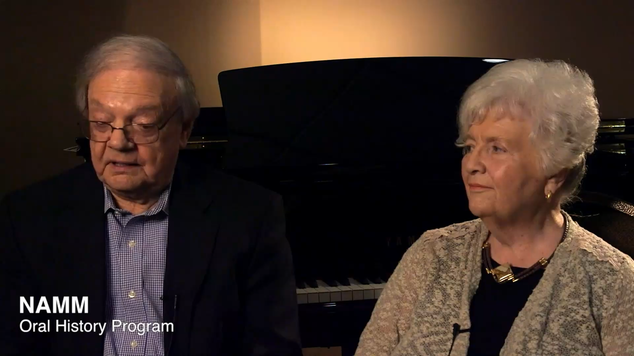

Slide 19
Now it's your turn!
In your groups, it’s time to create
your own retail store concept.

Slide 20
Share

Slide 21
Consider a Career in Music!
What careers are related to the lesson we just completed?
Music Retailer
Entrepreneur
Instrument Manufacturer
Store Design Specialist
Accountant
Human Resources
Marketer

Slide 22


